Slide 1
Thomas County Central High School eSports
Gaming With A Purpose

Slide 2
Introduction

Slide 3
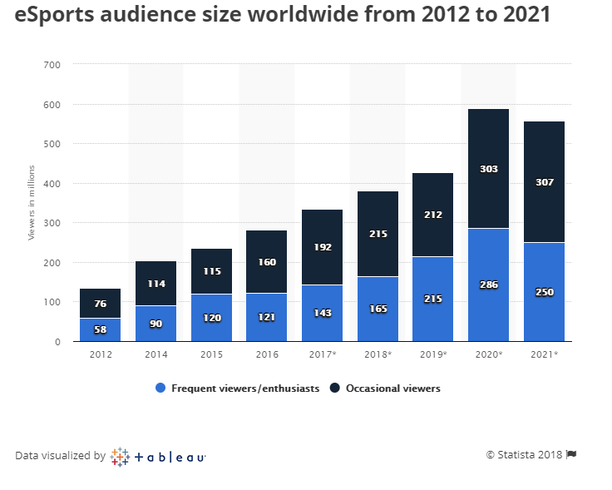
Why eSports?
Fastest growing sport in the world with viewership numbers exceeding the NFL
Teaches teamwork, cooperation, sportsmanship: traditional athletic goals
Targets an untapped demographic
Anyone can play, regardless of physical abilities
Open to ALL
Have fun…meet new people…make friends

Slide 4
College Scholarships
200+ colleges and universities now offer scholarships for eSports
Combined with the Hope scholarship, you could graduate without debt
Participation can improve chances of being accepted to college, just like traditional sports

Slide 8
Requirements to Participate
Meet GHSA eligibility
Maintain good character
Maintain good grades
Currently enrolled at TCCHS
Approval of Coach and Athletic Director
Must be willing to have fun

Slide 9
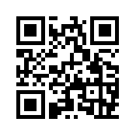
What Happens Next
Season One is starting February 25
Final date for sign-up will be January 18
Try-outs will start January 21
Visit bit.ly/2RAIphM

