Slide 1
Electricity and Magnetism Vocabulary

Slide 2
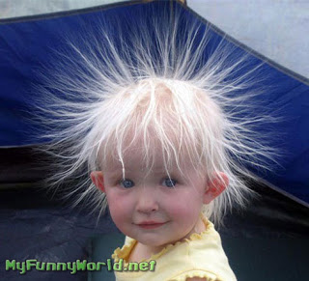
Static electricity
The buildup of electric charges in one place.

Slide 3
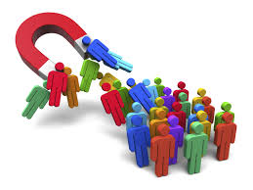
attract
To pull closer together
Opposites attract

Slide 4
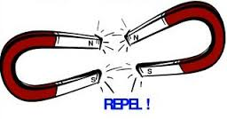
repel
To push away from
Alike charges repel

Slide 5
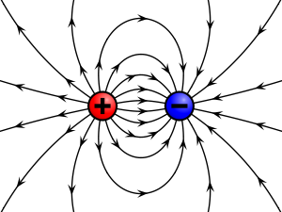
Electric charge
A basic charge of the tiny particles that make up matter
The charge can be positive or negative

Slide 6
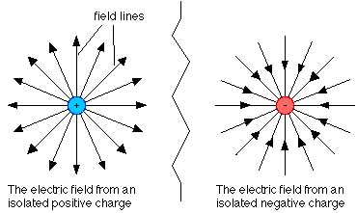
Electric field
The space around an electric charge, where the electric force can act.

Slide 7
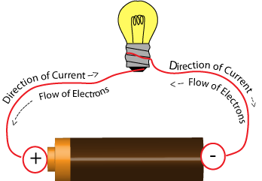
Electric current
A flow of electric charges

Slide 8
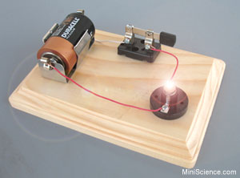
Electric circuit
A closed path that can carry an electric charge

Slide 9
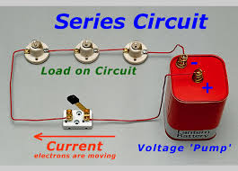
Series circuit
An electric circuit with only one path for current

Slide 10
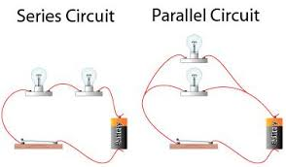
Parallel circuit
An electric circuit with two or more paths for current

Slide 11
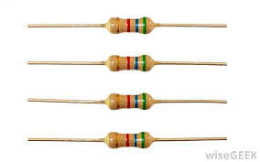
resistor
An electric device used in an electric circuit for protection

Slide 12
Short circuit
A short in a circuit that allows a large current to flow through where it isn’t wanted

Slide 13
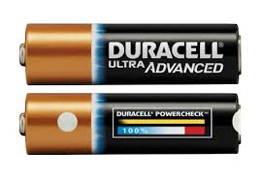
Power source
A device that supplies electric power

Slide 14
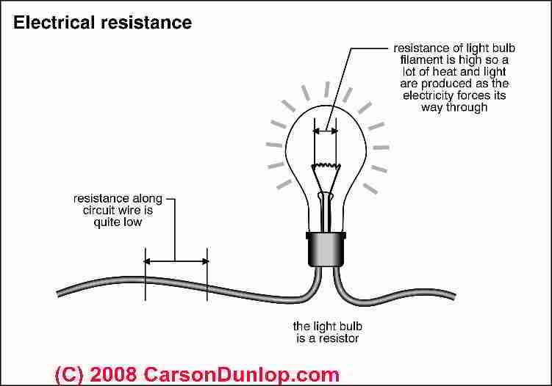
resistance
How much a material resists the flow of electric current

Slide 15
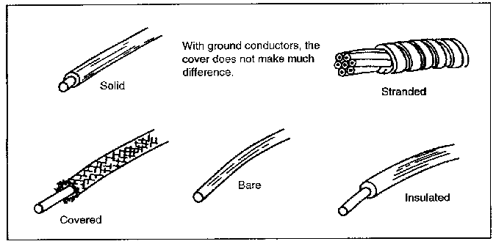
conductor
Something through which heat and electricity can flow easily

Slide 16
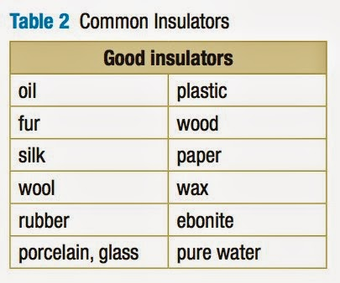
insulator
Something that slows down the flow of heat and electicity

Slide 17
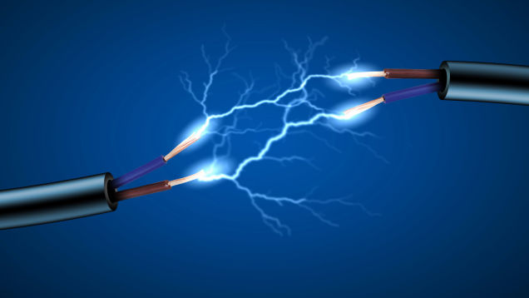
Electricity
Is the moving of charged particles

Slide 18
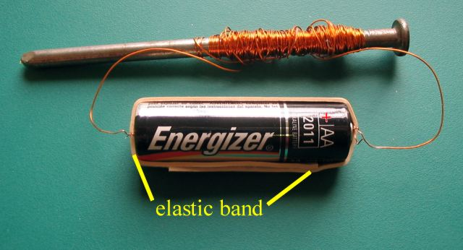
electromagnet
Is a magnet that has an iron center wrapped in wire that carries electric current

