Slide 1
Uncle Tom’s Cabin
By: Harriet Beecher Stowe
Published 1852

Slide 2

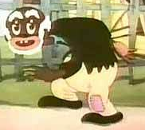

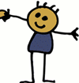
A Kentucky farmer named Arthur Shelby plans to sell two slaves to a slave trader named Mr. Haley in order to pay off some debts. The two slaves are a middle aged slave named Uncle Tom and a young boy named Harry.
Mr. Haley
Arthur Shelby
Uncle Tom
Harry

Slide 3



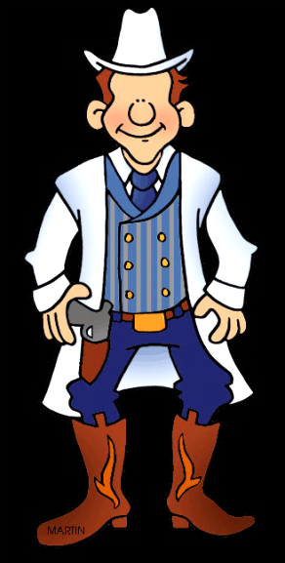
Harry’s mother, Eliza, overhears Mr. Shelby and flees with her son. Tom Loker is hired to bring her and her son back. Eliza escapes capture and crosses the Ohio River where a group of Quakers agree to get her to Canada. Eliza is reunited with her husband George before heading to Canada.
George
Eliza
Ohio River
Tom Loker

Slide 4


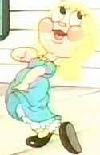
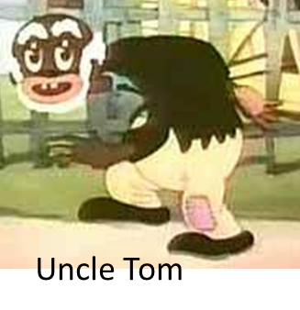
In the meantime, Uncle Tom is transported by Mr. Haley on the Mississippi River. He is befriended by a little white girl name Eva. Uncle Tom saves Eva from drowning when she accidentally falls into the water. Eva’s father Augustine St. Clare buys Uncle Tom and they travel to their home in New Orleans.
New Orleans, LA
Eva
St. Clare
Mississippi River

Slide 5

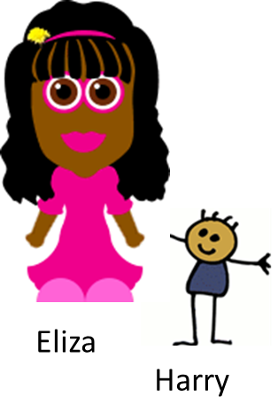

Up North, Eliza and George continue to evade capture by Mr. Loker. In one attempt Tom Loker is shot by George. Eliza and George take Loker to the Quakers to be healed.

Slide 6



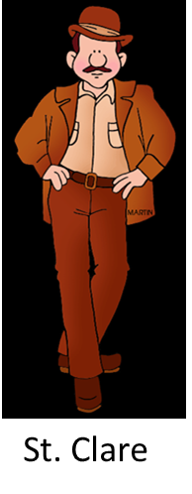


Uncle Tom lives with the St. Clare's for two years before Eva becomes very ill and dies. As a result of her death, St. Claire agrees to set Uncle Tom free. Before he can however, St. Clare is stabbed to death while trying to settle a fight.

Slide 7
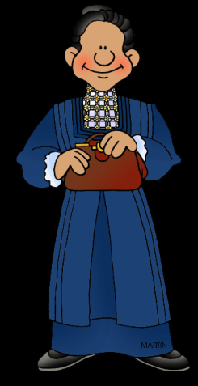
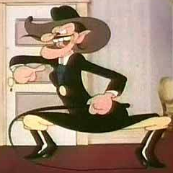
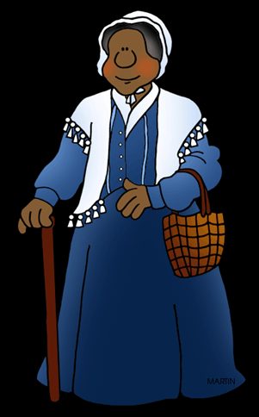
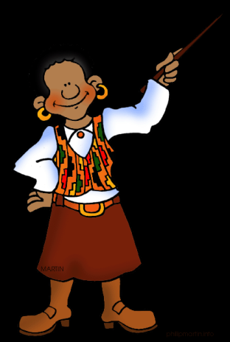
St. Clare’s cruel wife, Marie, sells Tom to a mean plantation owner named Simon Legree. Tom and another slave named Emmeline are taken to Louisiana. Legree dislikes Uncle Tom when Tom refuses to beat another slave. Tom meets another slave named Cassy who was separated from her daughter by slavery.
Marie
Cassy
Emmeline
Simon Legree

Slide 8



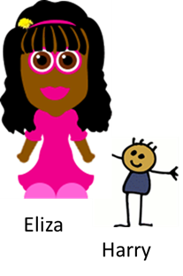
Tom Loker becomes a nice man after he is healed, and helps George, Eliza and Harry to finally cross into Canada from Lake Erie.
Canada
Lake
Erie

Slide 9
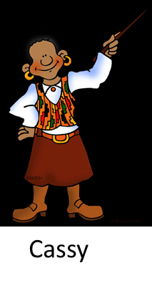
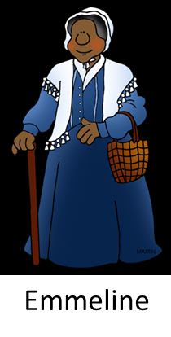
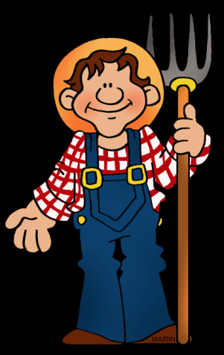
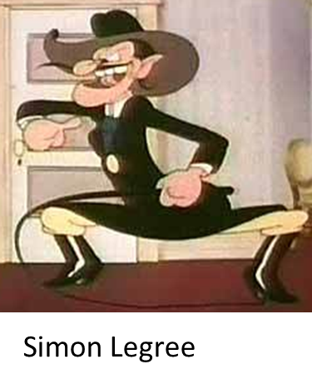


Tom convinces Emmeline and Cassy to escape. When Tom refuses to tell Legree where they went, he is severely beaten. Arthur Shelby’s son, George, arrives at the plantation to buy Tom’s freedom, but is too late. Uncle Tom dies a martyr’s death.
George Shelby

Slide 10

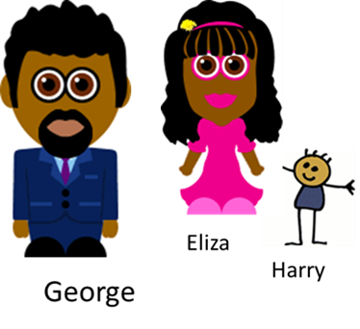

Emmeline and Cassy travel to Canada. Cassy meets Eliza and realizes she is her long lost daughter. The family then moves to France and finally to Liberia. George Shelby returns to the farm in Kentucky where he frees all the slaves in honor of Tom’s memory.
France

Slide 11
Northerner’s Reaction
Did not like the idea of slaves
Angry that slave owners could be cruel
Joined groups that were fighting to end slavery

Slide 12
Southerner’s Reaction
Slave owners were horrified
Thought book was false
Wrote books that showed how great slavery was

