Slide 1
The Great Salt Lake
An Enormous Lake

Slide 2
Great Salt Lake

Slide 4
Location
The Great Salt Lake, located in the northern part of the United States in the state of Utah, is the largest salt water lake in the Western Hemisphere, and the fourth-largest terminal lake in the world.

Slide 5
The Great Salt Lake is the largest natural lake west of the Mississippi River. At the current level the Great Salt Lake is approximately 75 miles long and about 35 miles wide. Located in several wide flat basins, a slight rise in water lever expands the surface area of the lake considerably. The first scientific measurements were taken in 1849 and since then the lake level has varied by 20 feet, shifting the shoreline in some places as much as 15 miles.

Slide 6
Great Salt Lake is always changing. Conditions vary with location, with the seasons, and from one year to the next. In order to survive, the plants, animals and microbes that live in and around Great Salt Lake must be able to adjust to their constantly changing environment. But they also must survive the lake's often extreme conditions.

Slide 7
Great Salt Lake is salty because it does not have an outlet. Tributary rivers are constantly bringing in small amounts of salt dissolved in their fresh water flow. Once in the Great Salt Lake much of the water evaporates leaving the salt behind

Slide 8
Great Salt Lake is too saline to support fish and most other aquatic species. Several types of algae live in the lake. Brine shrimp and brine flies can tolerate the high salt content and feed on the algae. Brine shrimp eggs are harvested commercially and are sold overseas as prawn food. The oft maligned brine flies do not bite or land on people and are the primary food source for many birds that migrate to the lake. For most of the summer brine flies form a ring around the entire shoreline and rarely venture more than a few feet from the water's edge. Biologists have estimated their population to be over one hundred billion

Slide 9
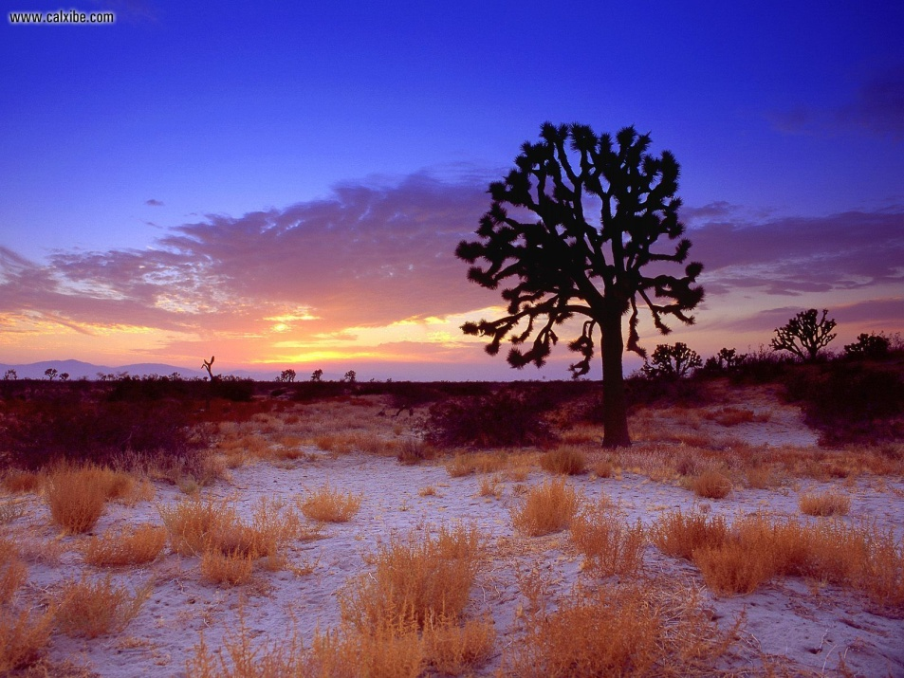
The Mojave Desert: A Unique Ecosystem

Slide 12
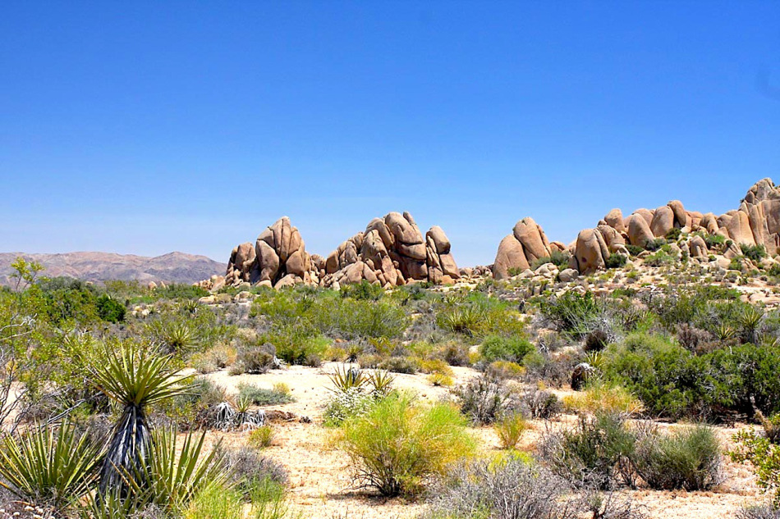

Slide 13
Geography
Approximately 25,000 square miles
Parts in California, Utah, Arizona, and Nevada
Mountain ranges, salt pans, seasonal saline lakes
Las Vegas is the largest city in the Mojave
Elevation mostly 2000 to 5000 feet
Colorado river and Mojave river (intermittent river)
Smallest North American desert

Slide 14
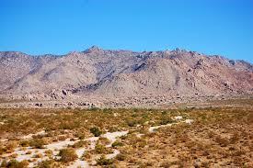

Slide 15
Climate
Temperature can go anywhere from 8°F to 119°F depending on season and time of day
25 mph winds have been recorded, and are common
July to September is thunderstorm season
Humidity is almost always below 40%, with the exception of some winter nights and after rain

