Slide 1
Citizen’s Rights & Amendments
Unit 2

Slide 2
A citizen is a person who has all the rights and responsibilities of belonging to a nation.
All people born in the U.S. are automatically U.S. citizens.
If a baby is born in another country, but one or both of the parents are U.S. citizens, the baby is also an American citizen.

Slide 3
Responsibilities and duties of citizens:
Voting – voluntary
Obey the law
Pay taxes
Serve on juries
Registering for military – men

Slide 4
The Constitution and Bill of Rights
The Bill of Rights contains the first ten amendments to the constitution.
These amendments were ratified, or agreed on, in 1791.

Slide 5
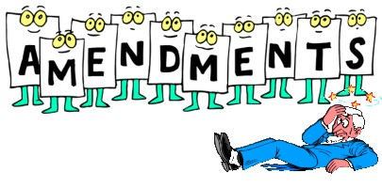

Slide 6
1st Amendment
Freedom of speech, freedom of press, right to assemble and right to petition.

Slide 7
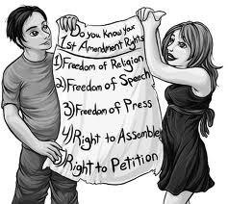

Slide 8
2nd Amendment
Right to keep and bear arms

Slide 9
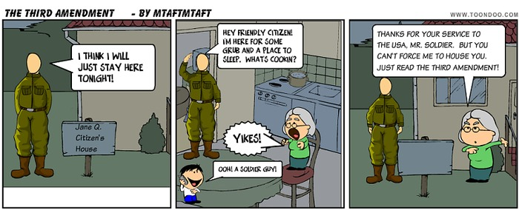
3rd Amendment
Protects people from having the military stay in their homes.

Slide 10
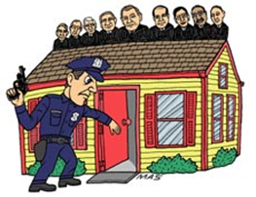
4th Amendment
Nobody can search (papers, persons, houses) and seizure (take from you) without reason

Slide 11
5th Amendment
right to due process of law.
law must be followed by the government and citizens.
Protection from double jeopardy- cannot be tried twice for same crime.
Right to “take the 5th” protects people from having to testify against themselves.
Government cannot take property without paying for it. The power of the government to take property is called eminent domain.

Slide 12
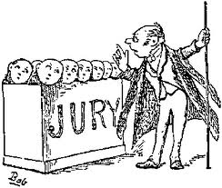
6th Amendment
Right for trial by jury of your peers

Slide 13
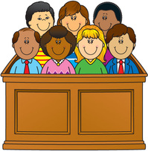
7th Amendment
Civil trial by jury. Civil law is not about crimes.

Slide 14
8th Amendment
Protects people from excessive bail.
Bail is the money that the court can charge to allow an accused person to not go to jail while waiting for trial.
It also protects people from cruel and unusual punishments

Slide 15
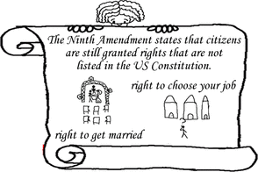
9th Amendment
Says that just because a right is not written in the Constitution does not mean that people do not have that right.

Slide 16
10th Amendment
Says that any power that is not given to the federal government in the Constitution is given to either the states or to the people.

Slide 17
Show what you know
What right granted by the Bill of Rights do you think is MOST important? Why?

Slide 18
The framers of the Constitution knew that over time, the document might need to be changes. They made the process possible, but not easy to do so it wouldn’t be changed too often

Slide 19
Amendments
1st step: propose, or suggest, the amendment.
2/3 of the senate and 2/3 of the House of Representatives have to vote and approve to put it in the process.
2nd step: congress sends the proposal to the governors of every state.
The state legislature then votes on ratification of the amendment.
Becomes an official amendment when three-quarters (38 states total) ratify it.

Slide 20
Amendments That Changed Voting
12th amendment
Before the 12th amendment, every candidate running for President ran for President by himself, regardless of political party. The electors would pick two of these candidates, one for President and one for Vice President
The most important part of the 12th amendment is that instead of casting two votes for President, each elector must pick a President AND a Vice President on his or her ballot. This ensures that the President will be paired with his running mate after the election

Slide 21
Amendments That Changed Voting
23rd amendment
gives residents of Washington DC the right to vote for representatives in the Electoral College
Before this, only citizens who lived in the states could vote in national elections

Slide 22
Amendments That Changed Voting
17th amendment
The people of a state now vote senators into office directly.
It allows the governor of a state to appoint, or choose, someone to serve in place of a senator if he/she dies or resigns.
Before this, senators were elected or appointed by state legislatures.

Slide 23
Amendments that protect the right vote
13th amendment- outlawed slavery
14th amendment: gave African Americans citizenship.
15th amendment: African American men over the age of 21 were allowed to vote.
19th amendment: gave women the right to vote.
24th amendment: Ended poll taxes or taxes charged to vote.
26th amendment: changed the national voting age to 18.

Slide 24
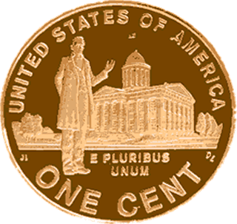
The Unites States official motto:
e pluribus unum = “out of the many, one”
The “many” stands for the colonies, or now, states.
The “one” is the whole U.S.

Slide 25
Show what you know
How would the U.S. be different today if there had not been amendments to protect the right to vote? Think about how voting worked before the Civil War. What effect would that system have if it were still in use today?

Slide 26
