Slide 1
What is OPEC?
SS7G7; SS7G8

Slide 2
What is OPEC?
O__________________ of
P___________________
E___________________
C___________________

Slide 3
What is OPEC?
Organization________ of
P___________________
E___________________
C___________________

Slide 4
What is OPEC?
Organization________ of
Petroleum___________
E___________________
C___________________

Slide 5
What is OPEC?
Organization________ of
Petroleum___________
Exporting___________
C___________________

Slide 6
What is OPEC?
Organization________ of
Petroleum___________
Exporting___________
Countries___________

Slide 7
OPEC.org
OPEC’s Objective:

Slide 8
OPEC.org
OPEC’s Objective:
Unify the petroleum policies if its Members and make sure the oil market is stable for producers, suppliers, consumers, and investors.

Slide 9
OPEC.org
List all of the members of OPEC that are located in SW Asia (Middle East)
Iran

Slide 10
OPEC.org
List all of the members of OPEC that are located in SW Asia (Middle East)
Iran
Iraq

Slide 11
OPEC.org
List all of the members of OPEC that are located in SW Asia (Middle East)
Iran
Iraq
Kuwait

Slide 12
OPEC.org
List all of the members of OPEC that are located in SW Asia (Middle East)
Iran
Iraq
Kuwait
Qatar

Slide 13
OPEC.org
List all of the members of OPEC that are located in SW Asia (Middle East)
Iran
Iraq
Kuwait
Qatar
Saudi Arabia

Slide 14
OPEC.org
List all of the members of OPEC that are located in SW Asia (Middle East)
Iran
Iraq
Kuwait
Qatar
Saudi Arabia
United Arab Emirates

Slide 15
OPEC.org
What does this objective really mean?

Slide 16
OPEC.org
What does this objective really mean?
They control how much oil is produced and how much it costs.

Slide 17
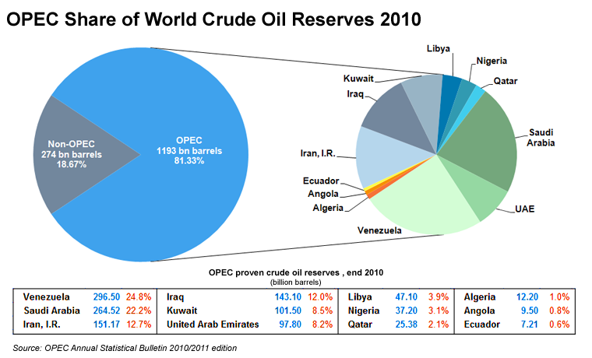
OPEC.org

Slide 18
OPEC.org
How does OPEC “stabilize” the market price of oil?

Slide 19
OPEC.org
How does OPEC “stabilize” the market price of oil?
They increase or decrease production as necessary, which in turn affects prices.

Slide 20
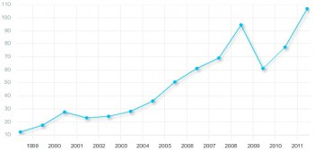
OPEC.org

Slide 21
Price Fixing
Definition: setting prices at a level that producers and distributors can agree on.

Slide 22
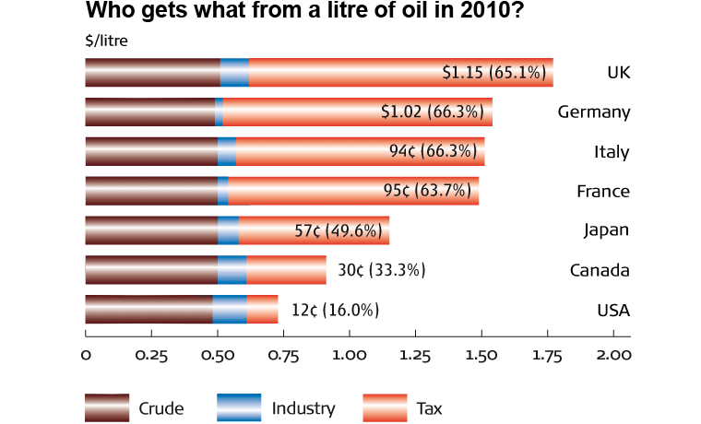
Price Fixing
*1 gal = 3.7 liters

