Slide 1
5th Grade
10 day Curriculum

Slide 2
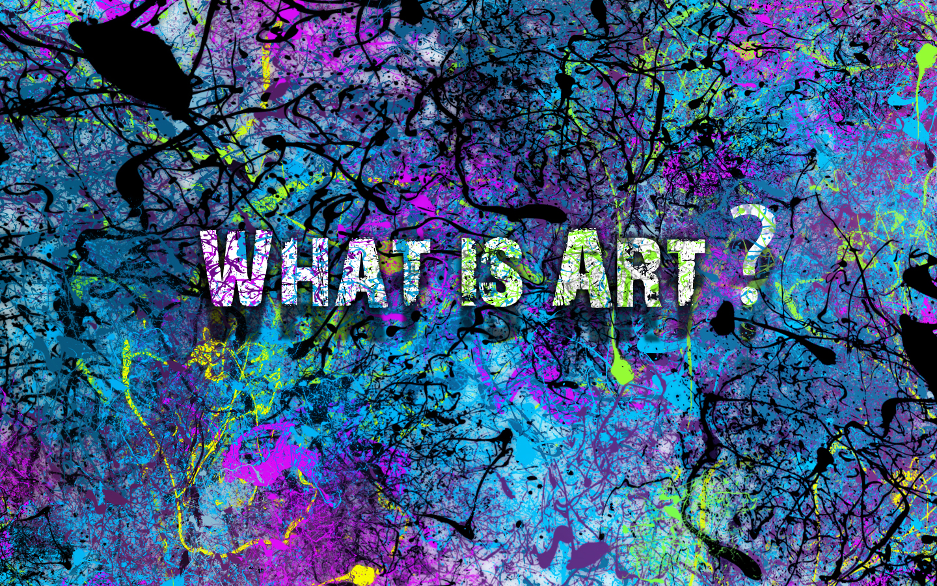

Slide 3
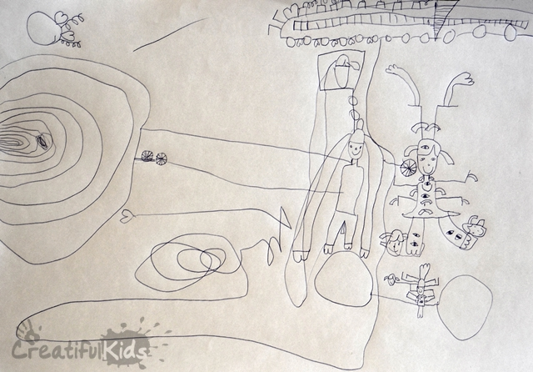
Day 1: I’m an artist!
Artist Statement
EQ: What makes you creative?

Slide 4
Day 2: What is color?
EQ: What is color?

Slide 5
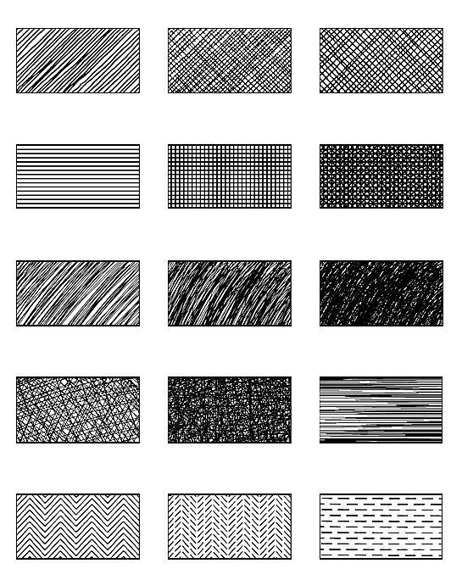
Day 3: What is Line?
EQ: What is Line?
Pen and Ink Techniques
Hatching
Cross-Hatching
Stippling
Draw your Shoe

Slide 6
DAY 4
EQ: What is shape?
Project: Roll-A-Matisse

Slide 7
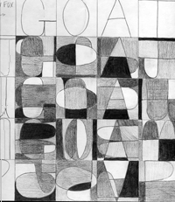
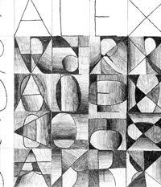
DAY 5
EQ: What is value?
Project: Value Name Design

Slide 8
Day 6
EQ: What is form?
Project: Henna Hands

Slide 9
Day 7
EQ: What is space?
Project: Contrast Project

Slide 10
Day 8
EQ: What is Texture?
Project: Roll-A-Monster

Slide 11
DAY 9
EQ: What are the elements and principles of art?
Project: Finish up any incomplete projects and take home.
Worksheets:
“I am an Artist”
Color Wheel
LEO Warm or Cool?
Line
Exploring Value
Projects:
Draw your Shoe/Line
Matisse/Shape
Name Design/Value
Henna Hands/Form
Contrast/Space
Monster/Texture

Slide 12
DAY 10
EQ: How can we make color yummy?
Project: Cookie Color Wheel

Slide 13
Fun Stuff
For extra days or times when you need it…lol!

Slide 14
Shirt Design
EQ: How can we create art like a graphic designer?
Project: Shirt Design
Take your time and explore your concept.
Imagine the design on a shirt.
Detail is king but keep things simple.
Consider your market.
Keep your humor subtle.
All about color!
Prepare your artwork properly.

Slide 15
Design a Puzzle
Draw a Puzzle Design
Directions
Draw a puzzle design using pencil.
Then color the puzzle pieces
Then cut them out along the dotted lines to create your own game.

Slide 16
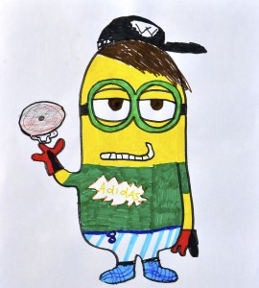
Make a Minion

Slide 17
Puzzle Mural
EQ: How can we create a mural group project?
Project: Puzzle Mural

Slide 18
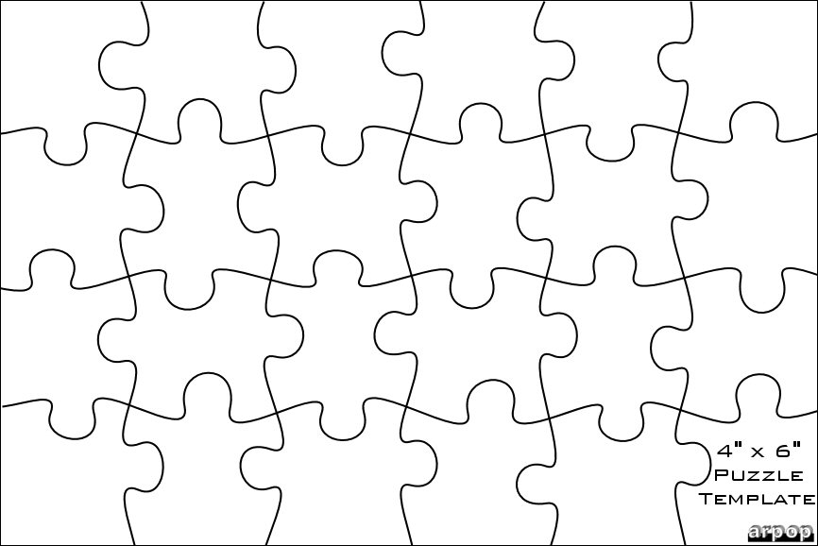
Design a Puzzle Piece
Design you puzzle piece.
Materials:
Markers
Colored Pencils
Crayons
Collage
Oil Pastels
Pencil
After everyone is complete we will put them together on the bulletin board.

Slide 19
Roll-A-Lego Person
Samples
Game Piece and Dice
Don’t forget a fun background!

